Slide 1
Jean Genet’s The Balcony (1956) – between cruelty and spectacle
Against mobility and fixity

Slide 2
Dilemma
In a spectacular world, a world of images and simulations, what role should theatre play?
If reality is already theatricalised, and not simply real or actual, what does this to do realism in the theatre?
What type of politics should theatre look to represent in a world where all politics are spectacular?

Slide 3
Theatre’s role is to wound; to attack spectacle (le jeu)
To do that, it has to attack or wound itself
To show that it does not represent a reality that is beyond it; but that reality is a construct, something false
Theatre always has to be double – to represent and to show that representation to be false at the same time
Theatre, then, is mobile; it undoes; it takes place

Slide 4
What is cruelty?
Puncturing illusions of humanism and humanist theatre
That the world cares little for human beings: ‘the sky can still fall on our heads’
That life is senseless, violent, cruel, in which love and strife are in a kind of cosmic battle
The only way forward is to accept cruelty and to accept violence of world – that everything falls apart and passes away
So cruelty not so much physical as metaphysical
By disturbing reality as it is, cruelty allowed history to move

Slide 5
What is spectacle?
A society based on images where watching is more important than doing
An unreal world, based on the commodity, capitalism is an image
A world of simulation and untruth
A world of living death, where people live separated from each other
A world of alienation and boredom – the mass media manage everything

Slide 6
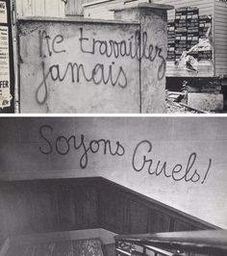

Slide 7


Slide 8


Slide 9


Slide 10
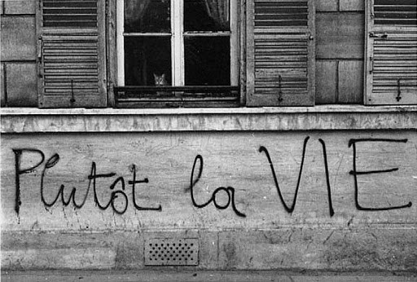

Slide 11
Quotes from Guy Debord’s Society of Spectacle
‘The spectacle is not a collection of images; it is a social relationship between people that is mediated by images’ (SoS, no.9)
‘The spectacle is the guardian of …sleep’ (no.21)
The spectacle is the ruling order’s non-stop discourse about itself; its never-ending monologue of self-praise; its self-portrait of the totalitarian domination of all aspects of life (no. 24)
‘In a world that is really upside down; the true is a moment of the false’ (no.9)

Slide 12
1968
Debord’s ideas huge influence on 1968 riots
But 1968 defeated by spectacle
So the question is: why did it fail? Why do people prefer servitude to liberation?
Perhaps because we can’t accept cruelty as a necessary part of living a different life, one without guarantees or safeguards

Slide 13
The Balcony
Genet’s play fits in with these two ideas, although written in 1956
The Balcony is a place of looking, a space where one is not occupied in actual life, but located in a place above it
To that extent, The Balcony is an allegory of theatre itself, a place where nothing actual happens, especially ideas of political theatre
Genet’s cruelty is found in revealing this: in showing us life as it; in puncturing liberal illusions

Slide 14
Jean Genet (1910-1986)
Why is Genet such an important figure?
Jean Genet is key because his work effectively spans the century, a writer between modernism and postmodernism, and can see this in the themes and tensions of his work.
A theatre that is neither realist nor Brechtian – a different kind of politics; one that brings to together Artaud and Debord.
Genet asks the question: why do we in West prefer reaction to revolution, fascism to freedom?

Slide 15
Who is Genet: period one
Jean Genet (1910 – 1986) – orphan, thief, prisoner, queer outlaw, political activist
Early career as an artist: novelist – queer novels, explicit sex, a new dream-like style of writing, concerned with appearance and reality, everyone playing roles, androgyny, transvestism, gender subversion.
Novels include Our Lady of Flowers, Miracle of Rose, Querelle de Brest, Funeral Rites,

Slide 16
A queer politics
Genet, then, a new voice, sexually explicit depiction of queer sex, when homosexuality was illegal and something to be hidden.
So a real politics of writing here, which influences queer culture and queer theory enormously
Genet also important for feminists in that shows gender to be role, a matter of wearing clothes, a figure of speech.

Slide 17
Genet’s second period
This corresponds with pardon from prison (1948) and important book about Genet – Saint Genet: Actor and Martyr – written by existentialist philosopher Jean-Paul Sartre
Genet move away from prison writings – novels – to theatre, to the way that mainstream society is predicated upon an illusion, a kind of brothel or pornography, in which images are used to mystify reality

Slide 18
This give rise to a series of political theatre starting with The Maids, and including the great political/historical trilogies of The Balcony, The Blacks, and The Screens (1956-191)
These plays offer direct engagement with current issues in French society, in particular, the rise of right-wing and fascism, racism and decolonization, and the Algerian war – a traumatic war for French society.

Slide 19
Politics of the wound
Wounding, for Genet, is when the subject is confronted with what they are not, internally;
So the wound is the return of the repressed; what the subject does not want to face – what we could call the impossible within, everything that undoes your identity, a kind of interior abyss
But the abyss – that wound – is also creative; it allows things to flow; history to move; the underside of spectacular existence

Slide 20
Aesthetic Politics
The plays provide an ‘oblique’ or indirect way of dealing with politics
For while highly critical of the established order in France, and always on side of the underdog (the maids, the rebels, Blacks, Algerians), they offer no message and remain aware of problems besetting revolutionary movements – they are critical.
Very different, then, from all models of political theatre on offer in time in France: popular theatre, militant theatre, committed theatre and Brechtian theatre

Slide 21
Third Period
The third period of Genet’s career starts when he becomes involved with Black Panthers and Palestinians in late 1960s
Like Artaud, Genet’s politics – anti-western, revolutionary, but again critical – he is aware of games that revolutionaries play, in particular their tendency to repeat mistakes of the established regime and their seduction by images, their obsession with heroism, their propaganda.

Slide 22
The common threads in Genet’s work
A hatred of France – anger, violence
Radical Freedom – sexual, gender, racial – more perhaps than class
Sensitivity to role playing and illusion
Theatricality of power
Power of image
Complexity and open-endedness, a reluctance to provide a message
Rejection of realism and prose – in its place abstraction and poetry

Slide 23
Genet in historical Context
Genet’s theatrical work is conditioned by traumas of French history
Instead of hiding that trauma, he discloses the wound, rubs French noses in the shit
Unveiling the repressed
WW II in which France was defeated and occupied by Germany and collaborated
Genet deconstructs myth of resistance used by de Gaulle and shows fascist tendencies within French culture

Slide 24
Decolonisation
1950s France, like UK, loss of colonies
Defeat in Vietnam of Indochina in 1954
1958 order for decolonisation – West Africa
So influx of Africans into metropolitan France, and significant rise in racism
Algeria a very different problem – seen as a part of France, so not willing to decolonise
Algerian War – 1954 – 1962 – it tears France apart.
Approaching state of civil war – the government and Republic brought down.

Slide 25
Other developments
1950s – capitalism, advertisements, reign of the image, television, cars, etc. – start to be seen in France
White heat of modernity
Paris is transformed – huge displacement of people into the banlieus (suburbs) beyond the periphérique/ ring-road – motivated by racism
Paris is white-washed
Algerian immigrants, African immigrants, marginalised, rendered invisible
People start to become alienated, living interior lives, fascinated by image culture…victims of spectacle.

Slide 26
Artaud and Genet
We can see influence of Artaud on Genet in terms of sexuality, nihilism, cynicism, revolution, images – the attack on reality itself
Like Artaud, The Balcony is a play that delights in inflicting cruelty on audience, on holding them accountable by revealing their delight in perversity and disclosing their hypocrisy.
This is where its politics reside; in attacking complacency, in showing sado-masochism of the subject
A theatre where feeling/effect is political

Slide 27
Le Balcon prefigures The Spectacle
The Balcony prefigures Debord by at least 10 years
The play shows the dangers of spectacle, what we could see as the dangers of theatre
For in the play, the revolution is defeated, not because they lack military power.
They win the battle and blow up the Balcony, but because the ruling class control the means of producing images
They colonize consciousness – the invert the real, making the truth false.

Slide 28
The Balcony – Politics of Theatre Itself
It seems essential to our understanding of The Balcony to start with a reading of the Avertissement (Note), which in French translates as both warning and preface
This will allow us to (a) grasp what it at stake in the play in terms of a politics of form/theatre; and (b) to understand Genet’s style of writing.

Slide 29
Importance
The ‘Note’ is a short but important text in history of political theatre because it problematises – takes seriously – the role and function of representation.
It is a text that assumes a close relationship between signs/images and reality
It looks forward to spectacle, the idea in which the real is a simulation, colonized by an image.

Slide 30
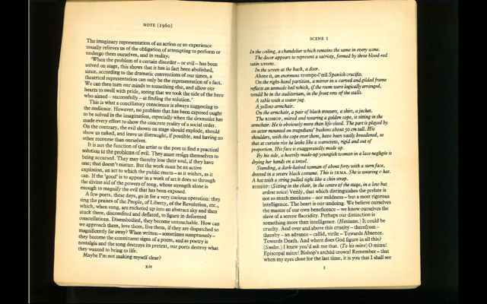

Slide 31
Rejectionism - Artaud
Genet rejects – catharsis – the idea in Aristotle that art releases anti-social energies
Genet rejects realism/naturalism because it is rooted in a representation of an extant fact – therefore how can it provoke something – a revolutionary consciousness – that is not in existence (Sartre)
Genet rejects political theatre for its idealism: its tendency to glorify the people (Brecht)

Slide 32
Genet’s response
A theatre that magnifies the evil in the world – this dialectical: the negative, the horror of it, produces the desire for change
A theatre that targets bodies, that shatters us, putting us in contact with repressed emotions and drives
A theatre that moves us: that shocks us, that gets under the skin
Genet’s point to create indeterminacy and doubt: to not give us a message, a solution
A theatre of form as much as content. Form is key.
A play about the politics of theatricality
A play that answers formally, the questions raised by content

Slide 33
So what is relationship between note and the play?
To understand this, we need to look at structure, form and content: to understand what the play is about, how it works, and how it makes us feel.
What is the play about? Its narrative: a play of ambiguity in which a ‘revolution’ that appears to be unfolding outside the brothel is defeated by the status quo through enlisting support of clients of brothel, and which shows that only change is for the worse: the fascism of Chief of Police.

Slide 34
Chief of Police/Brothel
Chief of Police – comes to power in a Brothel, ‘a house of illusions’
Irma’s brothel, a place where people play roles, live an inauthentic play
So Fascism, then, a movement not just of political power, but an image system
A seduction through images/spectacle (Debord)
But sadomasochism, unconscious desire, a desire not to be free (Artaud).
People desire their unfreedom

Slide 35
Impossibility
The problem with this reading of play’s narrative is that everything I have said is subject to doubt
How real is the revolution?
Is it just a brothel game designed for a client playing the role of a Chief of Police?
Is this all theatre, a scenario, something that is fundamentally false, a fake which tells us that it is fake?
And if so why would Genet do that? How does it fit with the Note, for instance?
No guarantees, no real meaning?

Slide 36
Dramaturgical structure
The play is structured in a circular fashion
So the whole thing comes to an end, only to appear to be about the start up again. Irma’s direct address to audience
This known as metatheatre, theatre that deconstructs itself, that highlights its own theatricality, self-referential
So what we get is theatre as opposed to reality/a theatre that not only is spectacular but that tells it is spectacular, undoes its own seduction
Un mise en abyme (putting reality into the abyss)
A performative play: its meaning is its doing.

Slide 37
Themes
Revolution – how it fails to come to power
Theory of Fascism – erotic / sadomasochism
Role of mass media in society of spectacle
Representations of History – history as history of winners
Reality and Representation – placing us in front of nothing/no illusions/reality is an image, false
Sexuality, power and glamour
Meditation on theatre and politics – spectacle again
Existential/Political function of brothel, pornography
Sado-masochism/ master-slave

Slide 38
Language/Laughter
Language in the play is ornate, beautiful, poetic…and very theatrical: it is not the language of everyday life
People in play seem to get drunk on language, to see it as a real thing, to believe in an essential reality where there is such a thing as the essence of a Bishop, Judge, Thief, etc.
Laughter in play is a kind of weapon: something that creates a distance, that highlights ridiculousness of what is going in.

Slide 39
Figures: the brothel
What does the brothel stand for – what happens in a brothel? Multiple significations/meanings
The play that we are seeing is called the Balcony, and the brothel is also called the Balcony?
Can we see the play as an allegory? If so what sort of allegory
How then do we interpret the figures?
What is their journey within the play?
What does it tell us about power/ideology?
How can we defeat the brothel? Can we defeat it?

Slide 40
Form of play
Theatricality constantly putting itself into question: note the first scene of Act I, with Irma and Bishop and the sound effects for the revolution
Acting style is not realistic; look, for instance, at Arthur’s death or ascension of Chief of Police
The costumes are fake: they wear platform heels; they are made-up; like puppets
Characters always talking about theatricality
Irma’s last speech shows that the whole thing is fake; she addresses us like clients
This is a play that has taken place in a brothel – i.e. theatre
So theatre is not real, like the brothel, it is a space of fakery where we pay for illusion, because we can’t deal with reality

Slide 41
Complex politics
Genet’s concept and practice of political theatre is complex
He refuses to give solutions; no didactics
Reminds us that theatre is always theatre, not reality
What we see then is a politics of theatre itself, the way that theatre represents reality.
The play is deconstructive: its power resides in his capacity to suspend meaning
In challenging us to accept this, to re-imagine the world, to come to terms with cruelty

